Slide 1
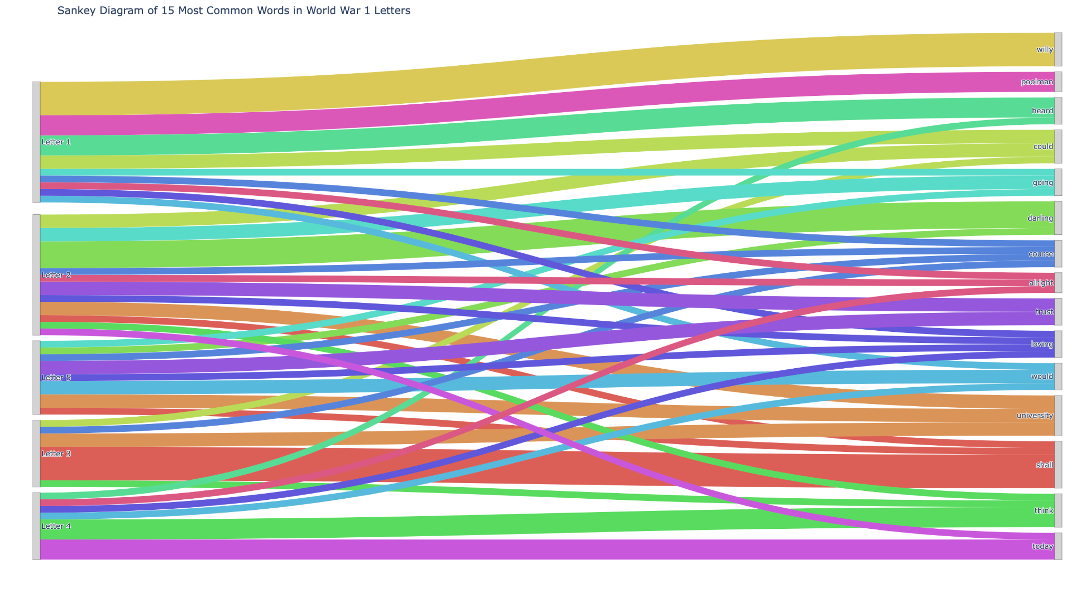
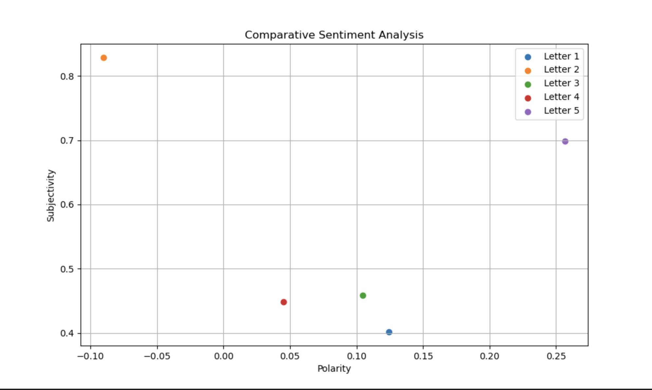
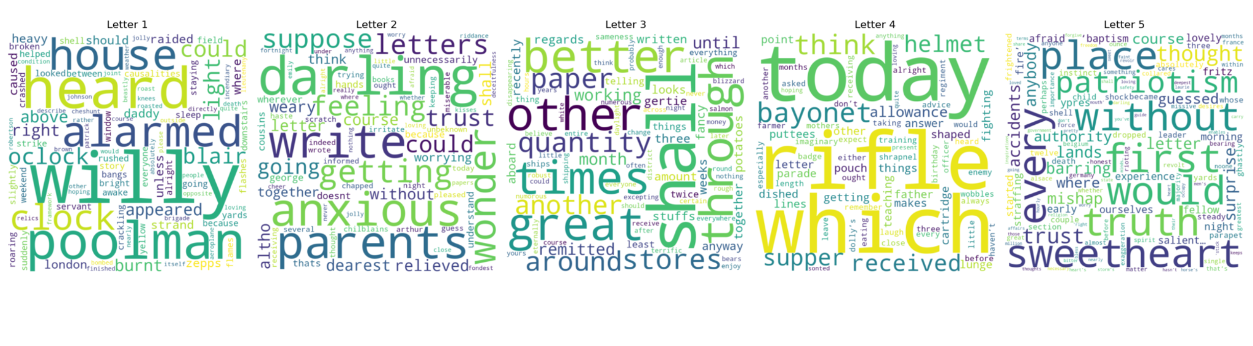
WW1 Soldier Letter Analysis
(Left): This is a sankey diagram depicting the k most common words among the World War 1 letters.
(Right): This is a sentiment analysis that shows a range of emotions. Through this you can see if soldiers just talked about daily life or if they showed their personal feelings and emotions.
(Bottom) : These are a set of word clouds that shows the most frequent words in each letter. Words like ‘darling’, ‘anxious’, ‘worrying’, ‘rifle’ , ‘bayonet’ were prevalent.
Sources: https://aggsliterature.wordpress.com/wwi-letters-home/ and https://www.iwm.org.uk/history/letters-to-loved-ones

